Slide 1
CPU Architecture SW-HW
Amichai Ben-David

Slide 2
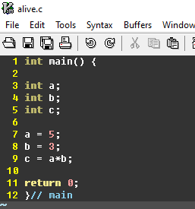
Program to Machine Code
C/assembly
Compile
Linker
Assembler
Machine code
System Verilog
Notes:
SDK – Software development Kit של RISCV מפותח ופשוט לשימוש. בשלב הראשון - צריך לכתוב קוד בC.

Slide 3
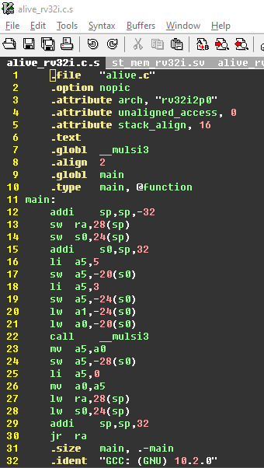
Program to Machine Code
C/assembly
Compile
Linker
Assembler
Machine code
System Verilog
Notes:
אותו האסמבלי צריך להתמע בתוך מערכת גדולה יותר – מעטפת של מערכת הפעלה או קרנל kernal.

Slide 4
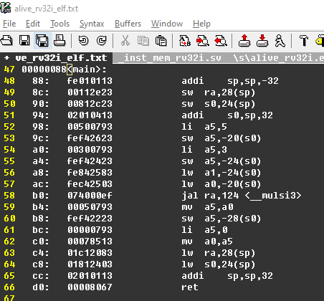
Program to Machine Code
C/assembly
Compile
Linker
Assembler
Machine code
System Verilog
Notes:
אותה חבילת SDK של GCC ניתן גם להמיר את הELF לפורמט Systemverilog לטעינת ROM או TAP וכו.

Slide 5
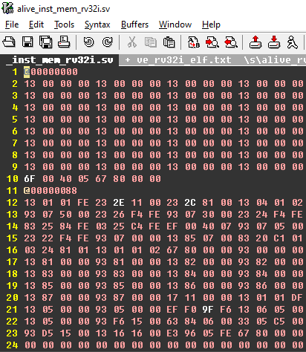
Program to Machine Code
C/assembly
Compile
Linker
Assembler
Machine code
System Verilog
Notes:
אציין שניתן למסך את כל התהליך הזה באמצעות לקיחת סיפריות linker קיימות ללא צורך בעריכה וירידה לרמה כזו של Toolchain – אבל כאשר רוצים לפתח מעבד לבד זה דיי הכרחי.

Slide 6
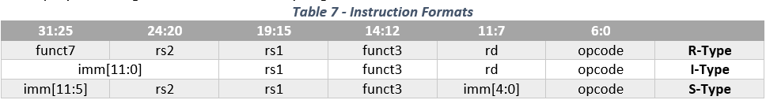
SS_RVC ISA – Instruction Set Architecture
In the “Subset RISCV Core“ we will support 3 instruction formats:
R-Type: Register<->Register operations (add,xor,or,and…) Example: add x3, x2, x1
I-Type: Register<->immediate operations(addi,xori,ori,andi…) Example: addi x3, x2, 1234
S-Type: Store Words to Memory Example: sw x3, 8(x2)

Slide 7
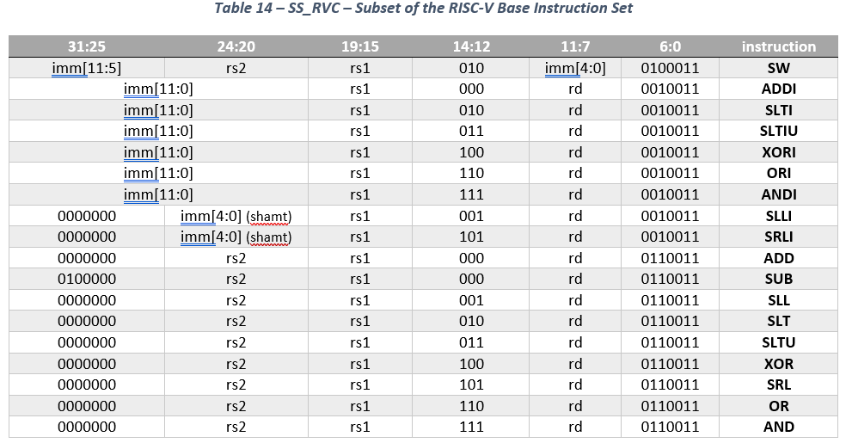
SS_RVC ISA – Instruction Set Architecture
The Subset RISCV ISA – Design Camp
S-Type
I-Type
R-Type

Slide 8
SS_RVC Hardware
Load Instruction memory before program starts the execution.

Slide 9
SS_RVC Hardware
Instruction Fetch
Program counter fitch.
Get the 32 bit instruction
PC

Slide 10
SS_RVC Hardware
Instruction Fetch
Program counter fitch.
Get the 32 bit instruction

Slide 11
SS_RVC Hardware
Instruction Fetch
Program counter fitch.
Get the 32 bit instruction
Instruction Decode
Read Register file
Detects Opcode and Set Ctrl Bits
Rs1 Rs2

Slide 12
SS_RVC Hardware
Instruction Fetch
Program counter fitch.
Get the 32 bit instruction
Instruction Decode
Read Register file
Detects Opcode and Set Ctrl Bits
Execute
Logic / Arithmetic operation on the data
Data1 Data2

Slide 13
SS_RVC Hardware
Instruction Fetch
Program counter fitch.
Get the 32 bit instruction
Instruction Decode
Read Register file
Detects Opcode and Set Ctrl Bits
Execute
Logic / Arithmetic operation on the data
Write Back
Data write to the “Destination Register”
Write Back

Slide 14
4 Stage Pipe-Line
SW x9, 8(x0)
0xC
XOR x5, x7, x8
0x8
ADDI x4, x5, 300
0x4
ADD x1, x2, x3
0x0
0x0

Slide 15
4 Stage Pipe-Line
SW x9, 8(x0)
0xC
XOR x5, x7, x8
0x8
ADDI x4, x5, 300
0x4
0x0
ADD x1, x2, x3
0x0
0x4

Slide 16
4 Stage Pipe-Line
SW x9, 8(x0)
0xC
XOR x5, x7, x8
0x8
ADDI x4, x5, 300
0x4
0x4
0x0
ADD x1, x2, x3
0x8

Slide 17
4 Stage Pipe-Line
SW x9, 8(x0)
0xC
XOR x5, x7, x8
0x8
0x4
0x8
0x0
ADDI x4, x5, 300
ADD x1, x2, x3
0xC

Slide 18
4 Stage Pipe-Line
SW x9, 8(x0)
0xC
0x8
0x4
0xC
0x0
XOR x5, x7, x8
ADDI x4, x5, 300
ADD x1, x2, x3
0x10

Slide 19
Data Hazards
The HW Should Support “Data Hazard”. A Hazard occurs when first instruction will update a register value, but the next instruction is already reading the “old” data.
xor x2, x1, x3 //x2 = x1 ^ x3
addi x3, x2, 15 //x3 = x2 + 15
Or x1, x3, x1 //x1 = x3 | x2
Solving the Hazards can be done using a “forwarding Unit”.

Slide 20
Data Hazards
xor x2, x1, x3
addi x3, x2, 15
Or x1, x3, x1
or x1,x3,x1
addi x3,x2,15
xor x2,x1,x3

Slide 21
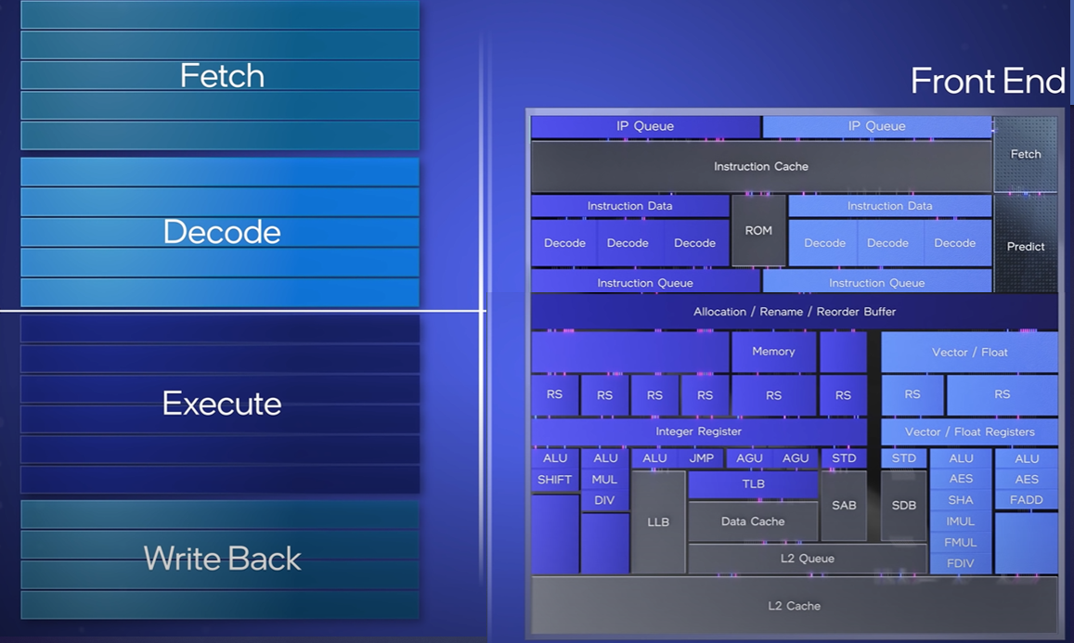
Modern CPU Architecture
Youtube - Modern CPU Architecture Part 1
Youtube - Modern CPU Architecture Part 2

Slide 22
Getting Started with MAS
Describe in a diagram the Data path
I-Type Data path
R-Type Data path
S-Type Data path
Understand where are the control bits needed
Selector on Muxes
Flip Flop Enables
Design the “Decode Table”
Input : Instruction (opcodes & Funct3/7)
Output : Control bits
Solve Data Hazards in HW.

